Slide 1
Food Procurement within the Public Sector in Scotland
Lynsey Gordon
Eating City Summer Campus
29th July 2017
Notes:
Good morning everyone, my name is Lynsey and I am a Senior Procurement Specialist for Scotland Excel.
Also, if you have any questions please feel free to ask at any time.

Slide 2
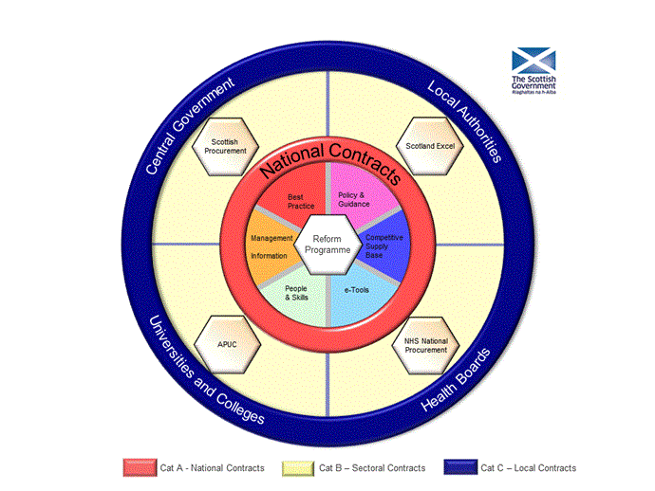
Background
Review of Public Sector Procurement – McClelland Report 2006
Main Findings
Not taking advantage of opportunities;
A new effective structure would be enforced and found to be more beneficial; and
Increased efficiency could bring about social and economic benefits
Notes:
So who is Scotland Excel?
Well, in 2006 the Scottish Government commissioned for a review to be undertaken on public sector procurement in Scotland by John McClelland – known as the “McClelland Report”. The report provided many findings, one of which was to create “Centres of Expertise” for the different Government departments and so Scotland Excel was founded in 2008 to carry out procurement for all local authorities in Scotland.
We work in partnership with local authorities to develop and deliver best value collaborative contracts. Everything that we deliver in Scotland Excel has an impact on the lives of someone in our communities, whether it is the community meals delivered to the elderly, the collection of our bins or in the work that I do on managing and tendering the food contracts, the impact on children and young people in Scotland.

Slide 3
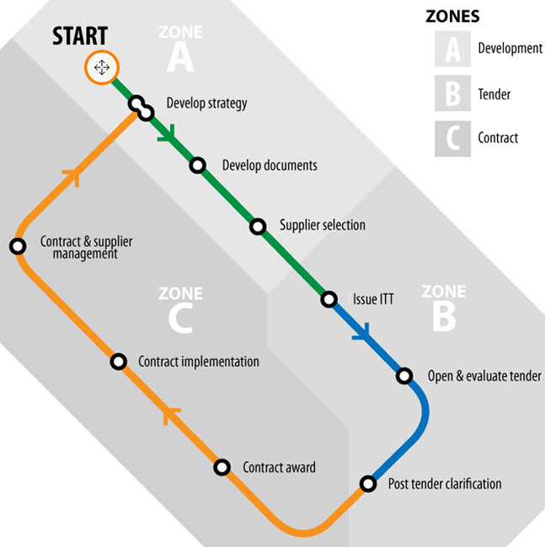
Scotland Excel
Our current live contracts spend is c£704m
We advertise all our contract opportunities through the “Public Contracts Scotland” advertising portal
Our contracts are mostly framework agreements which are generally split into one or more lots
70% of our current contracts are serviced by SME’s – more than half are Scottish Based
As participants in the Scottish Government's Suppliers Charter, we offer open and fair access to contract opportunities for companies of all sizes.
Notes:
Within Scotland Excel we have a wide range of contracts such as building and construction, social care, education, ICT, roads management, vehicles and of course food.
All of our contracts (and all public sector contracts within Scotland) are advertised through on online advertising portal called Public Contracts Scotland as well as the Official Journal of the European Union.
Across our portfolio of contracts, approximately 70% of our currents are serviced by Small to Medium Enterprises (SMEs) with more than half of these based in Scotland and we try as much as possible to make our frameworks fair and accessibly for companies of all sizes.
Also included on the slide is a picture of the Scottish Government’s Procurement Journey that is the process that we follow for our tendering activities. This is split into 3 zones:
Zone A – Development Stage (develop strategy, engage with the market place and develop the tender documents)
Zone B – Tender Stage (issue the tender to market, tender returns and its time to evaluate)
Zone C – Contract Management (award the contract to the successful suppliers, mobilise and implement the contract and then manage for the duration of the contract)

Slide 4
Scotland Excel – Food Frameworks
4 main food contracts worth approximately £70 million
15 suppliers awarded across the 4 contracts, with Scottish companies representing 12 of these suppliers.
Many challenges including 32 different agendas, policies and politics that need to be considered.
EU Public Procurement Legislation
Public Sector Procurement (Scotland) Regulations 2016 and Procurement Reform (Scotland) Act 2014
Notes:
With approximately £150million spent annually within the public sector in Scotland on food and drink, and Scotland Excels frameworks representing nearly 50% of this, it vital that we ensure we are ahead of the market, are aware of legislation changes and any other external factors that could have an effect on how the contracts operate.
Within Scotland Excel we have 4 main food contracts (Milk, Butcher Meat, Groceries and Frozen) which collectively are worth approximately £70million per year.
Across these contracts we work with 15 suppliers, with 12 of these 15 suppliers being classed as Scottish. I have also just awarded a new contract where we will see an additional 9 suppliers on the framework with 4 of these suppliers being Scottish.
One of our biggest challenges is the fact that we do work with 32 local authorities. As a result we have varying agendas, policies, politics etc. that we need to try and incorporate into our contracts. As well as this we also need to abide by the EU Procurement Legislation which was introduced in order to promote fair and open competition across all public sector bodies in the EU.
As well as these laws, Scottish contracts must also abide by the Procurement (Scotland) Regulations 2016 and the Procurement Reform (Scotland) Act 2014. These laws in Scotland mean that we need to put out all our contracts electronically, for a minimum of 19 days (ideally we go for 28) and that we cannot go out on 100% price. There must be a technical element included. Questions that we include here are about supply chain traceability, delivery of service, reducing food waste, recycling of packaging, reducing food miles and CO2 emissions etc.

Slide 5
Where We Were
Where we were
No lot breakdown
Country of Origin was not important
Minimum market engagement
Notes:
WHERE WE WERE:
In order to demonstrate how far we have come in the last 9 years it is important to tell you where we began in 2008.
Lots
When we first started we would separate our contracts into local authorities areas and suppliers were able to select what areas they could service across Scotland. However, suppliers would be penalised if they did not bid for all of Scotland. This meant that smaller companies would be disadvantaged compared to the larger companies as it would not be possible for them to service all of Scotland and to have the correct distribution network in place.
Country of Origin
As the focus was about achieving best value for the local authorities, there was no real drive for locally sourced products. High quality was always an issue but if this came from countries thousands of miles away this didn’t matter and the food miles, CO2 emissions, etc. were not considered

Slide 6
“Being Sustainable in Everything we do”
Sourcing Local
Developing the Supply Chain
Community Benefits
Sustainability
Future Goals
Notes:
Following on from the horsemeat scandal of Europe in 2013, where food advertised as beef was found to contain undeclared horse meat, there was a paradigm shift within Scotland Excel and the food frameworks to put more focus on sustainable food. This approach to sustainability was later rolled out within Scotland Excel with the organisation changing one of our vision and goals of “Being Sustainable in Everything we do”.

Slide 7
Where We Are
Where we are
Sourcing Local
Developing the Supply Chain
Changing the Market Place
Extensive Stakeholder Engagement
Softer Benefits
Notes:
WHERE WE ARE NOW
So following on from the horsemeat and change in our focus to being more sustainable, we have invested a lot of time and effort to ensure that we are delivering the best contracts possible to our customers. This has included
Sourcing more local produce
Developing the supply chain
Changing the market place to increase more competition
Extensive stakeholder management; and
Focusing not just on monetary savings but what softer benefits we can get from the contracts and give back to communities.

Slide 8
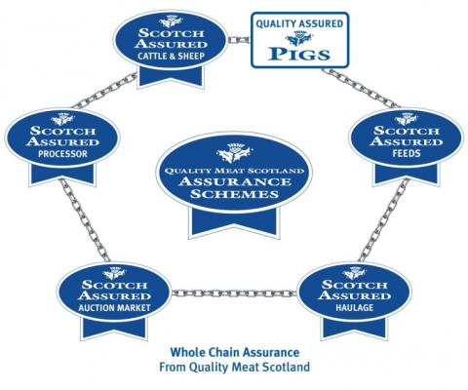
Sourcing Local
Year 1:
80%
Year 2:
17%
Notes:
The Scottish Government found that many in the food service sector had insufficient connection to their food and drink producers and the reputation enjoyed by their products with many people not knowing where the food has originated from and whether what they are eating and drinking is Scottish or not. In 2015 I travelled round Scotland to met with all the local authorities to carry out a review of their school meals in order to determine what they wanted from my food contracts. The most predominant theme across the board was locally sourced products. Therefore, these last 2 years, this has become a key aspect in our food contracts with more and more people wanting to know where their food is coming from and to have the ability to purchase Scottish produce where possible.
Within our butcher meat framework, we wanted to include more Scottish meat – especially since its something that we are proud of! In order to achieve this and still be in line with the EU Procurement Regulations, we were able to ask for Scottish beef and lamb products by including Protected Geographical Indication (PGI) or equivalent in our tenders. As our suppliers were pricing for these products and also based in Scotland they included a number of other Scottish meat products in their tender submission. Within the first year of the contract we saw an increase of 80% on Scottish products. This continued to increase into the 2nd year by a further 17% and we are hoping to see a further increase later in the year at the end of year 3.

Slide 9
Sourcing Local
Notes:
In May 2015 , the Scottish Government launched its Dairy Action Plan which provides a commitment to develop a strong Scottish dairy brand with the goal to increase the consumption in schools of Scottish cheese, butter, yoghurt and other dairy products. While all the milk provided through the Scotland Excel framework is Scottish, Scotland Excel alongside local authorities, were keen to see what could be done to increase the use of Scottish products within other dairy products.
Following engagement with local authorities, the decision was taken to include a list of dairy products for suppliers to provide for with a country of origin of Scotland. Now, as we are bound by EU regulations and therefore cannot stipulate a brand or country of origin on a product so as not to discriminate against other tenderers, consultation was held with legal who were happy for Scotland Excel to proceed with this secondary basket of goods as long as it was not commercially evaluated, therefore no-one would be disadvantaged if they did or did not offer for Scottish products.
As a result of this exercise a range of Scottish dairy products are now available for local authorities to purchase, with local authorities recently switching cheese from an Irish product to a Scottish company – an increase of approx. £1.1million

Slide 10
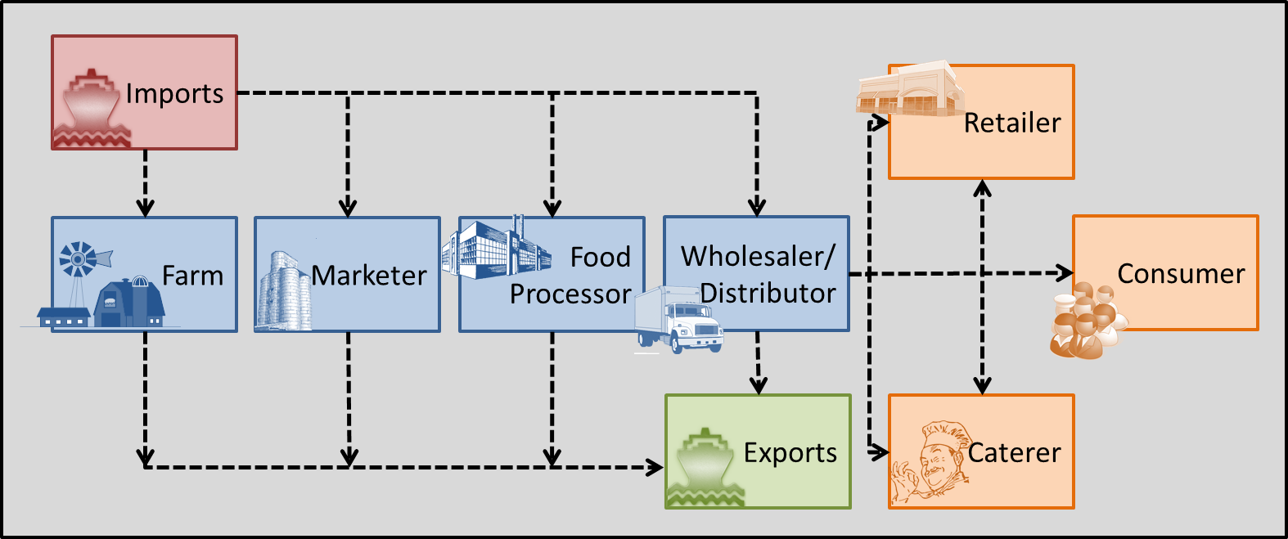
Developing the Supply Chain
Notes:
As well as looking at sourcing local / Scottish products where possible, Scotland Excel have also been working with suppliers to help bring Scottish SMEs on to our frameworks where possible.
Previously I mentioned that suppliers would be penalised if they did not bid for all of Scotland. However, we soon learned that this was not the best approach and would not help smaller companies. We therefore split our frameworks into different local authority areas where by a supplier could bid for 1, any or all 32 local authority areas without being penalised. In some cases, we also split a local authority into further regional lots if they know of local suppliers that may be able to bid for certain parts of their authority but not all of it. This resulted in our milk framework having 56 lots!
We also where appropriate split our tenders into different product lots to allow suppliers to be able to bid for the lot applicable to them for example in our butcher meat framework we have a lot for fresh fish that fishmongers can bid for without being penalised for not bidding for the fresh meat lot.
The number of suppliers awarded onto the two frameworks in the last 12 months increased the number of SMEs from 1 to 9. The previous SME supplier who was on the framework also increased the local authorities they offered for from 2 to 4.
Scotland Excel has been engaging with suppliers to help bring Scottish SMEs on to our frameworks where possible. Within the frozen foods commodity, KPI’s were identified to measure how well suppliers are supporting the local economy. An annual target is set for the supplier and this initiative has resulted in innovative new products from Scottish SMEs including:
A Pizzini (a mix between calzone and panini); and
A healthier pizza – made with wholemeal flour and seaweed
The success of this initiative meant it was included in our groceries framework which went live last year and Scotland Excel will be working together with the contracted suppliers and local authorities throughout the lifetime of the framework to further develop the supply chain within this framework.

Slide 11
Changing the Market Place
Notes:
When I was a participant at Eating City last year, I found it very inspiring listening to the speakers from across the globe such as Betina, and I left with lots of ideas of how I wanted to do
As a result I approached the market in a new way for the first time in a Scotland Excel contract by allowing manufacturers / producers to bid directly for the products that they were able to produce / manufacture without having to worry about the distribution element. This meant that the manufacturers / producers were able to put in a competitive price for their products. The distribution element was put into a separate lot where the wholesalers were able to tender a percentage on-cost for being the wheels out to local authorities.
By approaching the market in this way I:
Increased competition in an uncompetitive market;
Provided smaller manufacturers / producers to be able to bid for a national contract without having to worry about distribution. This resulted in 6 new SMEs onto the framework;
Allowed for Scottish SMEs to bid for their products where as a wholesaler may have bid with products from other countries.
The number of sustainable meat and fish products on the framework increased from 48% to 72% including for the first time a British Red Tractor chicken products that local authorities will be able to buy instead of the product from the current wholesaler which comes from Thailand.
I also clearly defined in my tender what I meant by a Country of Origin of Scotland and a Manufactured in Scotland product so that suppliers were clear of the difference and would be able to report back to me through quarterly statistics where applicable. This will also be used within the local authorities as part of a “Scottie Dog” brand logo where school kitchens will include a Scottie Dog on their menu with a different coloured tartan if the produce on the menu has either originated in Scotland or been manufactured in Scotland.

Slide 12
Extensive Stakeholder Engagement
Notes:
As I mentioned a few slides back, we didn’t use to be good at talking to our market and our stakeholders. We would talk and listen to our local authorities but that was it. Now however we work hard to engage and build relationships not only with our supply base but also with a number of different bodies within the food industry in Scotland.
With Quality Meat Scotland, National Farmers Union Scotland and Scotland Food and Drink, these are industry bodies that we engage with prior to tender development so that we can hear any market information that may be relevant to the tender and also for them to highlight to their members about any opportunities that are coming to market.
The Soil Association Scotland do a lot of work with local authorities in Scotland to achieve their Food for Life Accreditation. This is on 3 levels:
Bronze – has fixed standards. These focus on removing harmful additives and trans fats from the menu, and ensuring that the majority of food available is prepared freshly. They also focus on assurances that meat is traceable and from farms that adhere at least to minimum standards of animal welfare.
Silver and Gold – are assessed on a points system, rewarding spend on ethical, environmentally friendly and local ingredients, and for actions that make healthy eating easier.
As a result of these accreditations, it is important to engage with the Soil Association to ensure how contracts have the right goods available for local authorities to be able to purchase to obtain their accreditation
Following on from the horsemeat scandal, Scotland Excel took the lead on a cross-sector collaboration group to improve response times, communication and approach to dealing with food fraud in the public sector. This involved working closely with the Scottish Government, Food Standards Scotland and the other Centres of Expertise.
We also have continual engagement with our supply base when we invite suppliers in to discuss new tender opportunities with them, we then hold a tenderer information session prior to tender release to talk the suppliers through the tendering system and a high over view of what to expect from our tenders. Finally we hold regular (normally quarterly) meetings with our awarded suppliers as part of contract management.

Slide 13
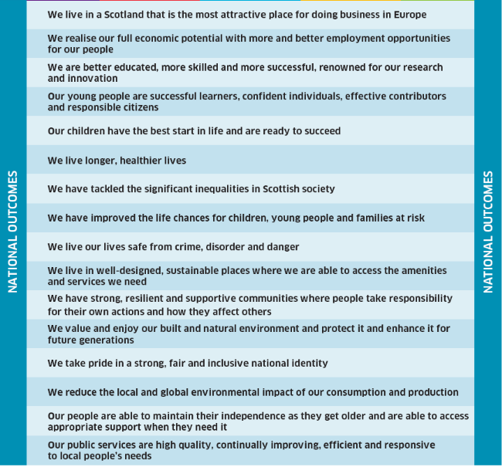
Softer Benefits
Notes:
When it comes to 3rd generation frameworks there isnt as much monetary savings to be gained as you have already achieved that over the first 2 generations. It is therefore important to see what else we can achieve from our frameworks.
As part of the Procurement Reform Act, public sector contracts over a certain threshold (£4m) in Scotland must contain a question on community benefits. Community benefits are one of a range of social and environmental considerations that can be included in public contracts
Community benefits are normally asked for at a national level on Scotland Excel frameworks rather than individual local authority basis. However, to try and ensure that all local authorities would receive community benefits directly from the framework, Scotland Excel asked for these for the first time on a local authority by local authority basis within the groceries framework and now within the new frozen foods framework
Across our food portfolio, a range of community benefit initiatives have been offered that suppliers would commit to deliver during the lifetime of the framework including:
work experience and apprenticeships
training and development on healthy eating and food origin
providing Scottish SMEs access to supplier networks and customer bases
educational competitions
food donations to local food banks
attendance at career fairs to provide advice and guidance for students keen to know more about industry, and
sponsorship of local community projects and charities.
Some suppliers have also offered a 1-2% of a local authorities spend with them to be given back to the local authority in a form of community benefit of their choosing. This may not seem a lot of money but when a local authorities spend can range from £200k-£2m per annum this can add up.

Slide 14
Future Goals / Aspirations
Public Procurement restrictions regards local sourcing – potential with Brexit?
Improved financing into Scottish manufacturing – i.e. Scottish chicken supply and demand
Increased awareness from Scottish Government to make suppliers “tender ready”
Education of young people – allotments in schools?
More funding for hospitality training for youngsters
Appropriate pay for low sector workers
Notes:
Public Procurement restrictions regards local sourcing – potential with Brexit?
Improved financing into Scottish manufacturing – i.e. Scottish chicken supply and demand
Increased awareness from Scottish Government to make suppliers “tender ready” – we have dispelled the myth that we only want to work with the large suppliers but the smaller supplies need help in knowing how to complete a tender correctly.
Education of young people – allotments in schools?
More funding for hospitality training for youngsters
Appropriate pay for low sector workers – we are also looking at seeing how we can include additional technical questions in our new milk tender regarding the price paid per litre to farmers for their milk to ensure that they are receiving a fair and sustainable price.
And finally, some additional things we would like to achieve would include:
The Living Wage
Food waste reduction targets
Zero waste targets; and finally
To continue to increase the amount of food served in Scottish schools to come from local, affordable and sustainable sources.

Slide 15
Thank you
Questions

